Slide 1
Team Tetrix
Car IO

Slide 2
Main Objectives
Hardware
Lane Following
Obstacle Detection (Overtaking)
Parking

Slide 3
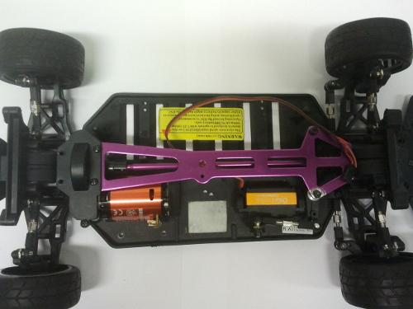
Hardware Concept
Vehicle Body
Plastic Chassis
Aluminium platforms
All-wheel drive

Slide 4
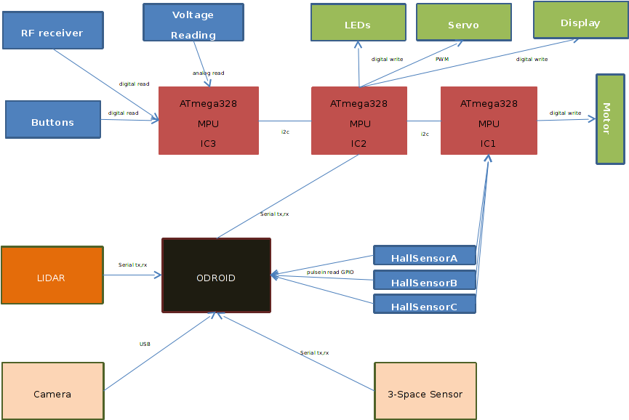
Hardware Concept
Odroid X2,
Self- developed PCB Board
Communication: I2C, Serial GPIO, USB

Slide 5
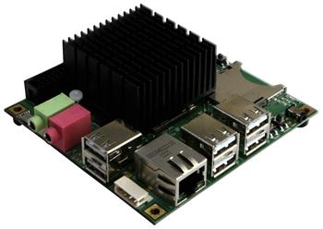
Hardware Concept
Mainboard: Odroid X2
CPU: Arm Cortex-A9 Quad Core, 1.7 GHz
6x USB 2.0 Ports
50 pin I/0 Expansion port for LCD/I2C/UART/SPI/ADC/GPIO

Slide 6
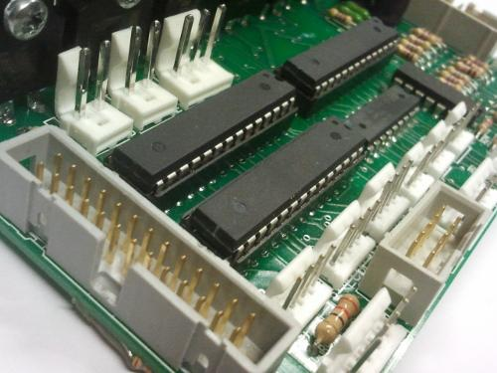
Hardware Concept
Self-developed PCB
3 x AtMega 328 microprocessor units
6 High-current transistors
5 volt regulator

Slide 7
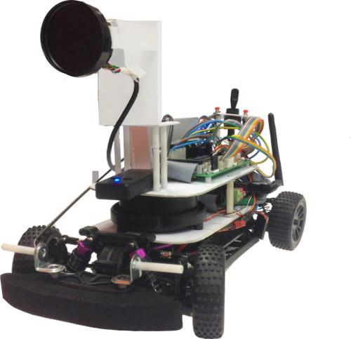
Sensor Concept

Slide 8
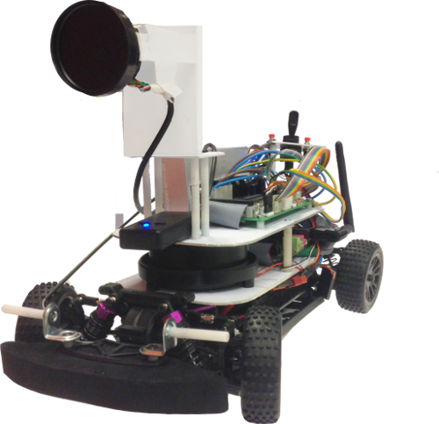
Sensor Concept
Monochrome Camera: Lane detection, Stop line detection
Lidar Sensor: Object detection
3 Space Sensor: Map Generation, Heading, Current Position
Hall Sensor: Current Position

Slide 9
Sensor Concept
Monochrome Camera: Lane detection, Stop line detection
Lidar Sensor: Object detection
3 Space Sensor: Map Generation, Heading, Current Position
Hall Sensor: Current Position

Slide 10
Sensor Concept
Monochrome Camera: Lane detection, Stop line detection
Lidar Sensor: Object detection
3 Space Sensor: Map Generation, Heading, Current Position
Hall Sensor: Current Position

Slide 11
Sensor Concept
Monochrome Camera: Lane detection, Stop line detection
Lidar Sensor: Object detection
3 Space Sensor: Map Generation, Heading, Current Position
Hall Sensor: Current Position

Slide 12
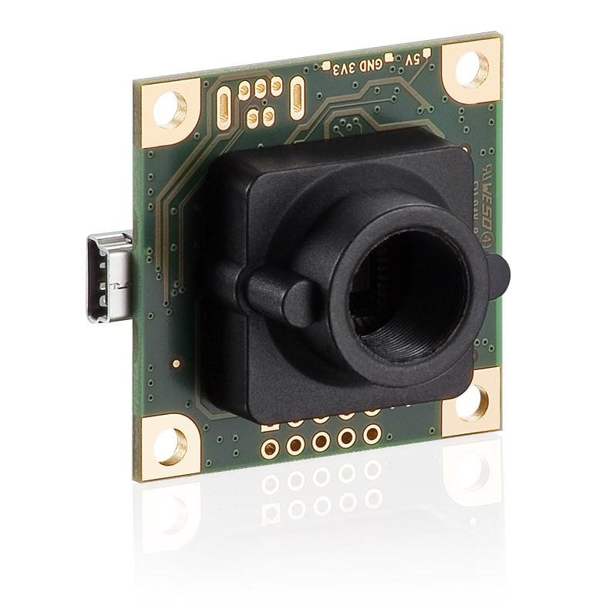
Monochrome Camera
Camera
Resolution: 752 x 480
Max. Frame Rate: 87.2 fps
Current Frame Rate: 46 fps
Lenses
Fish eye lense with 185° view
Polarization filter

Slide 13
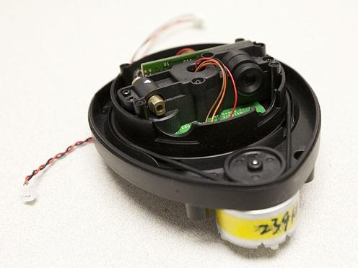
Lidar Sensor
360° scanning, 5x per second
1 degree accuracy
10 Hz refresh rate

Slide 14
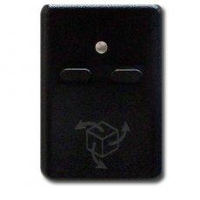
3 Space Sensor
Attitude Heading Reference System(AHRS)
Inertial Measurement Unit (IMU)
Orientation range of 360°
Orientation accuracy of ± 1° for dynamic conditions and all orientations
QGRAD AHRS filter updates at rate of 830 Hz

Slide 15
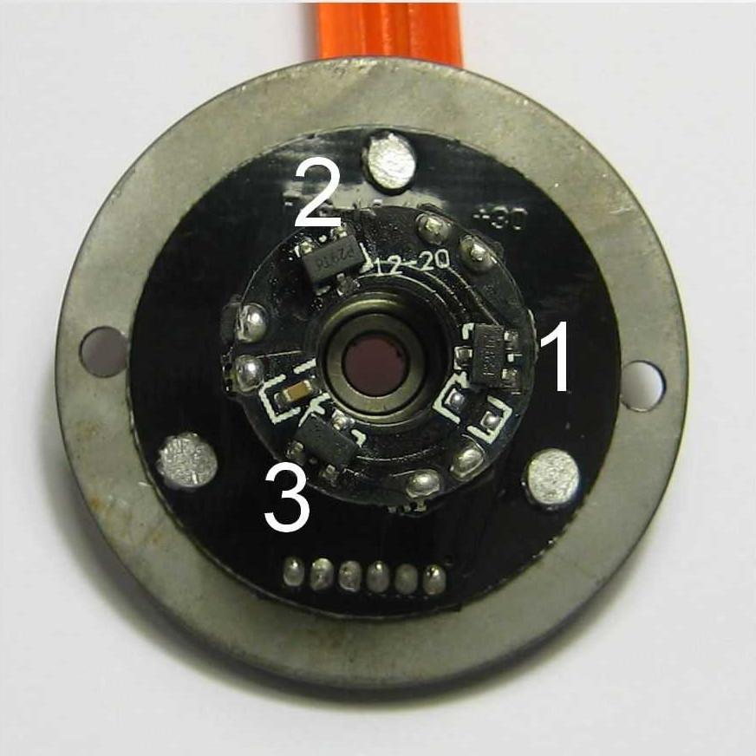
Hall Sensor
Built-in with motor
3 Hall Sensors
6 possible values
5 millimeter precision

Slide 16
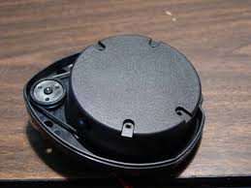
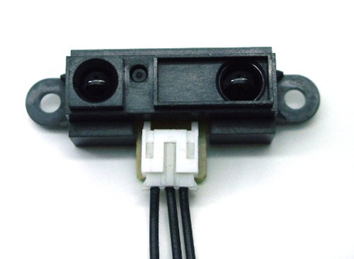
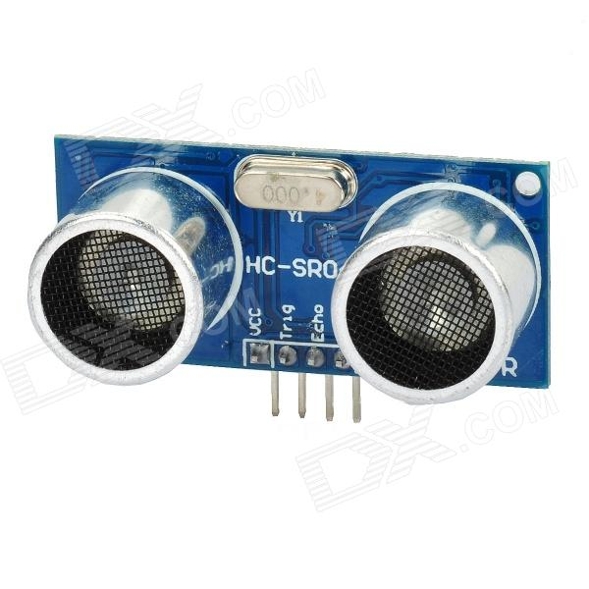
Different Approaches
Type | Lidar | Infrared Sensor | Ultrasonic
Max Range | 7 Meters | 30 Centimeters | 11 Meters
Minimum Range | 15 CM | 4 Centimeters | 3 Centimeters
Accuracy | 3 Meters | 30 Centimeters | 6 Meters
Data Update | 200 Millisec/Cycle | 35 Millisec | 65 Millisec
Communication | Serial | Analog | I2C
Power Consumption | 3.3 v | 5 v | 5 v

Slide 17
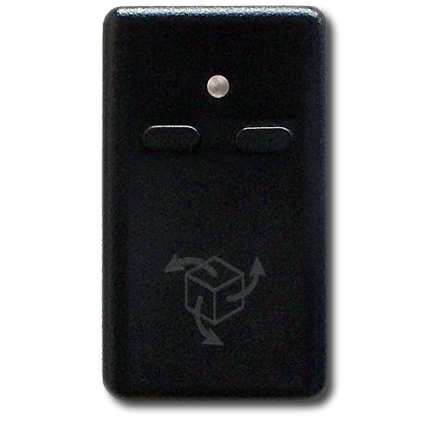
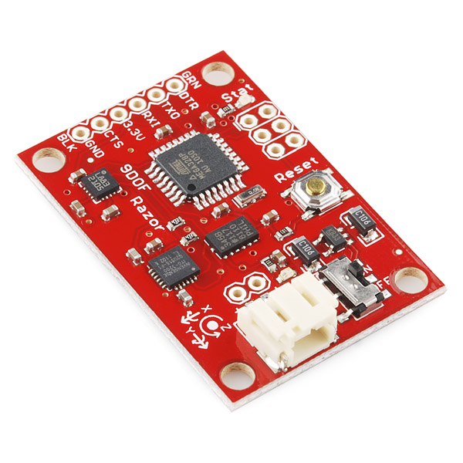
Different Approaches
YEI 3Space I.M.U | Razor 9DoF
Gyro, Accelerometer, Magnetometer | Gyro, Accelerometer, Magnetometer
Data Correction | No Correction
Data Filtering (Karlman) | No Filter
Protective Shell (For Interference). | No Shell
Serial Reading | Serial Reading
Minimum interference | Extreme interference

Slide 18
Software Concept
Operating System
Debian 7 (Wheezy)
Armel Architecture
Framework
Erlang OTP
Optimized for fault tolerance and concurrency
Code Base
C, C++, Python, Erlang, Bash
OpenCV, Erl Nifs (C to Erlang)

Slide 19
Cost
Car Cost | 344 EUR
Car | 170 EUR
Car Shell | 34 EUR
Motor | 72 EUR
Servo | 68 EUR
Boards | 554 EUR
Odroid X2 | 100 EUR
Memory | 58 EUR
PCB | 230 EUR
PCB Components | 60 EUR
PCB Heatsink | 30 EUR
Crimping, Cabling | 66 EUR
Sensors | 843 EUR
Camera | 323 EUR
Camera Lense | 317 EUR
Lidar (Neato XV-15) | 81 EUR
3 Space Sensor | 122 EUR
Side cost:
Digital Remote: 136 EUR
Total Cost | 1741 EUR

Slide 20
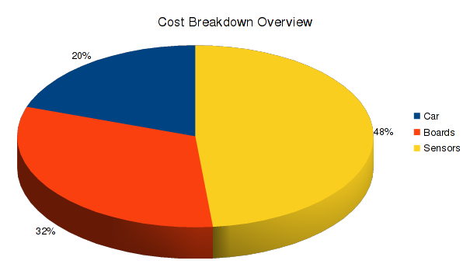
Cost
Largest cost: Sensors (56%)

Slide 21
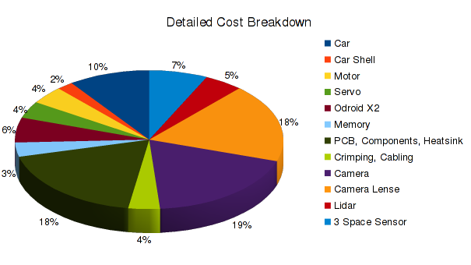
Cost
Largest expenses: Camera, Camera Lense, Self-Made PCB, Car

Slide 22
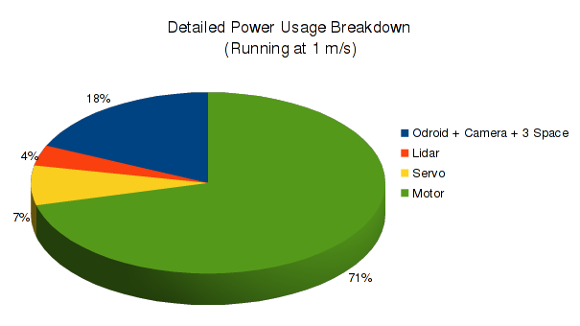
Energy Balance
Total Power Usage at 1 m/s | 66,2 W
Odroid X2 + Camera + 3 Space | 2.4 W
Lidar | 2.4 W
Servo | 4.7 W
Motor at 1 m/s | 47 W

Slide 23
Main Objectives
Hardware
Lane Following
Obstacle Detection (Overtaking)
Parking

Slide 24
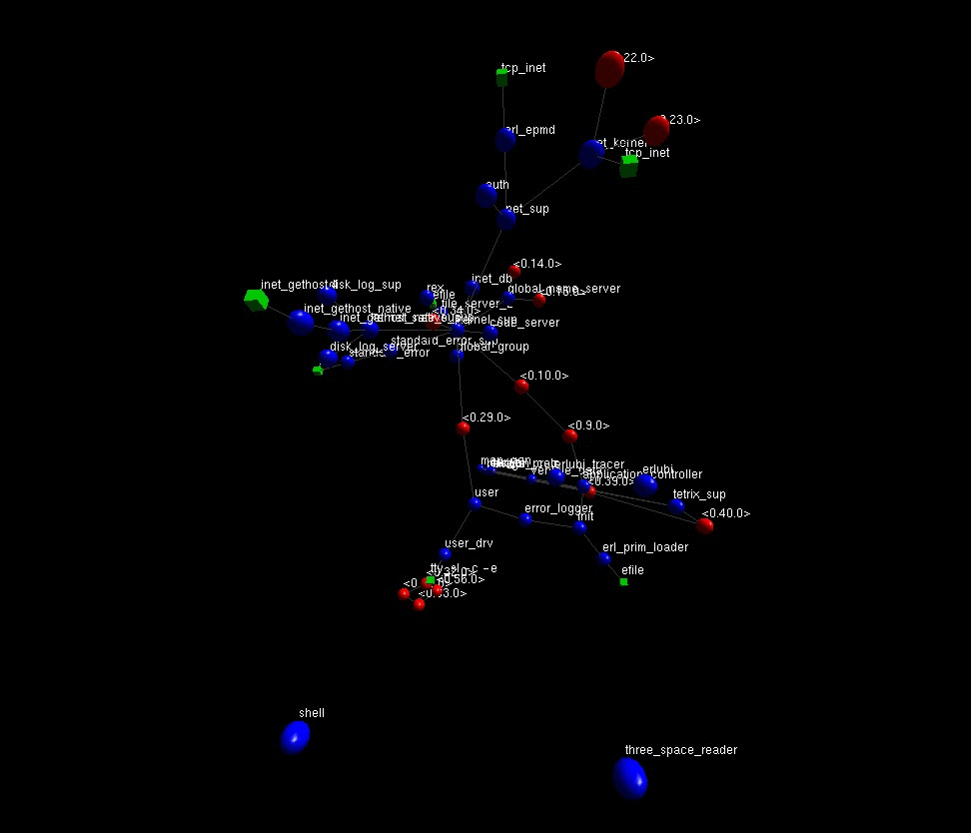
Software Concept
Erlang Processes Visualized

Slide 25
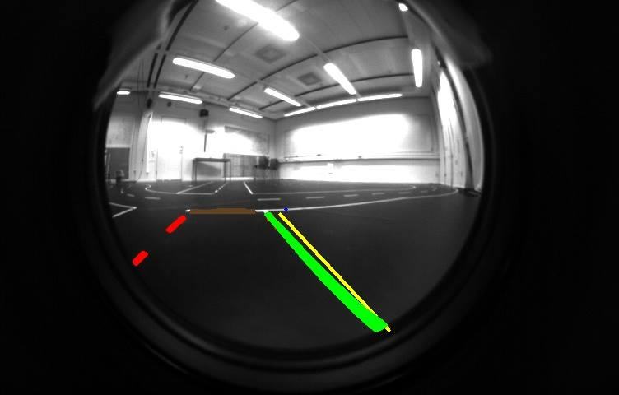
Lane Detection Algorithms
Detect white lines from image.
Sort lines.
Identify lane markings (right, left, middle, intersection, stop line, etc).

Slide 26
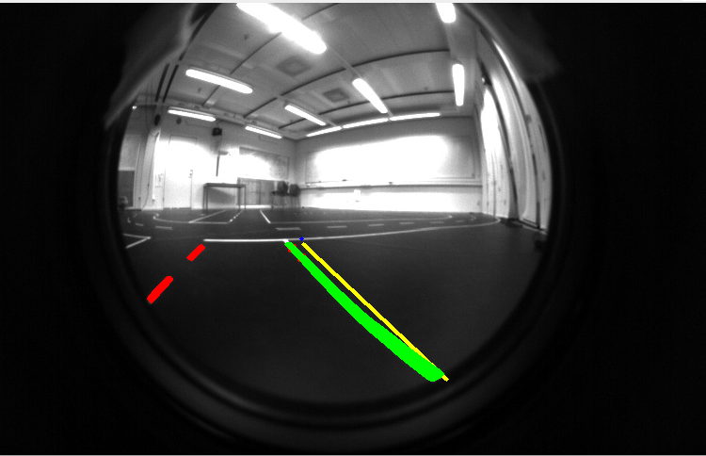
Lane Detection Algorithms
Handling Intersection:
Identify 3 points on the side lane.
Confirm that the points are on the lower half of the image.
Find an angle between 80 and 100 Degrees.
Confirm that the angle within a specific range of the right lane.
Match the first two points against the neighbouring dash line for confirmation.

Slide 27
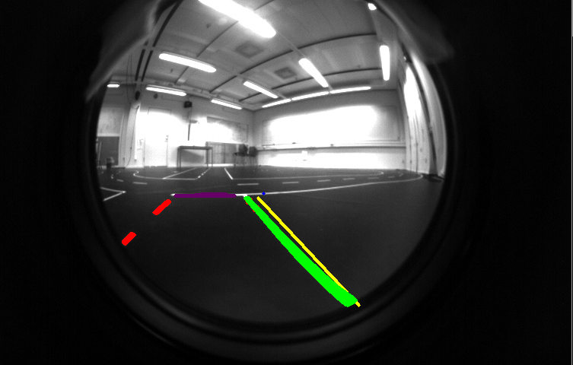
Lane Detection Algorithms
Handling Stop-Line:
Identify a valid intersection.
Confirm intersection against a neighbouring dash line.
Identify two points that form a horizontal line ahead.
Match intersection points against stop line points.

Slide 28
Map Generation
Map is generated during first lap around the course
Car IO uses the map to guide itself around the environment
Map allows the car to drive at an accelerated speed

Slide 29
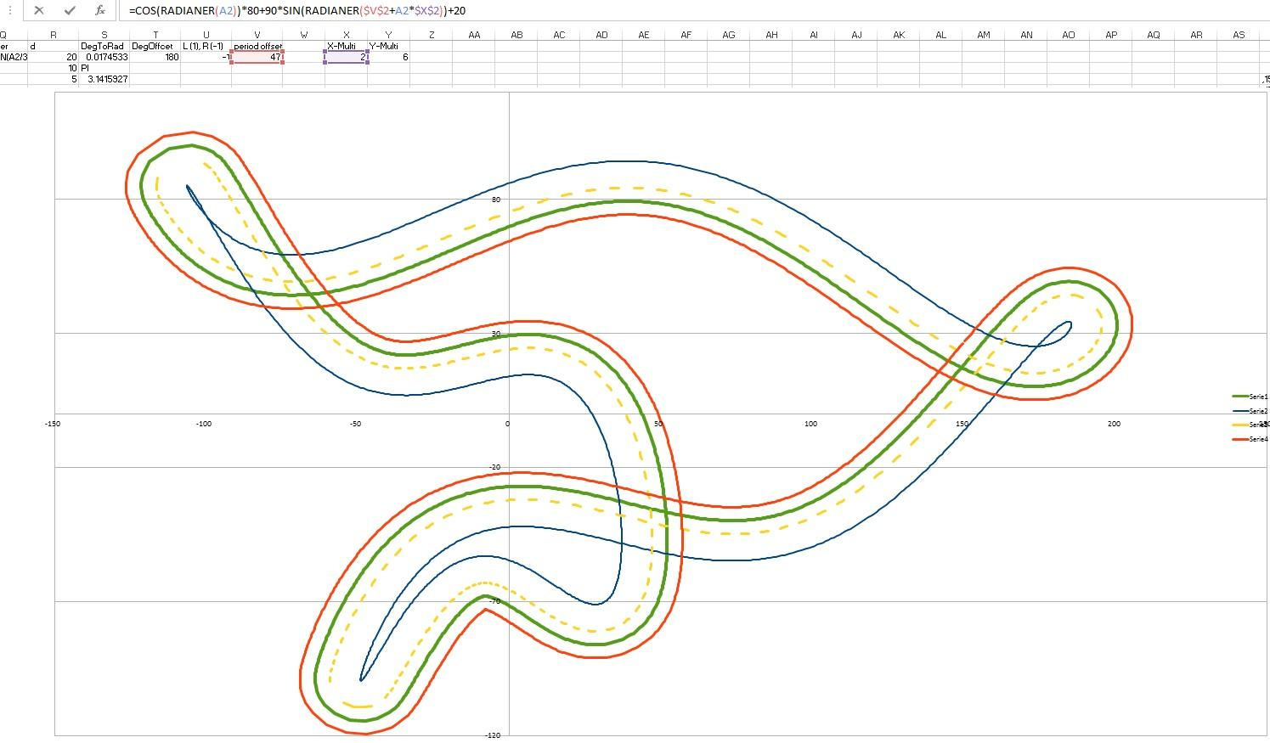
Offset Calculation

Slide 30
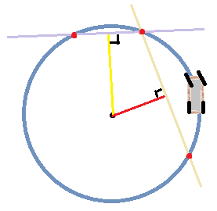
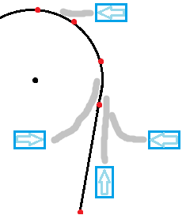
Steering
Find Circle from points in a dashed line
Perpendicular Steering
Correcting steering path

Slide 31
Main Objectives
Lane Following
Obstacle Detection (Overtaking)
Parking

Slide 32
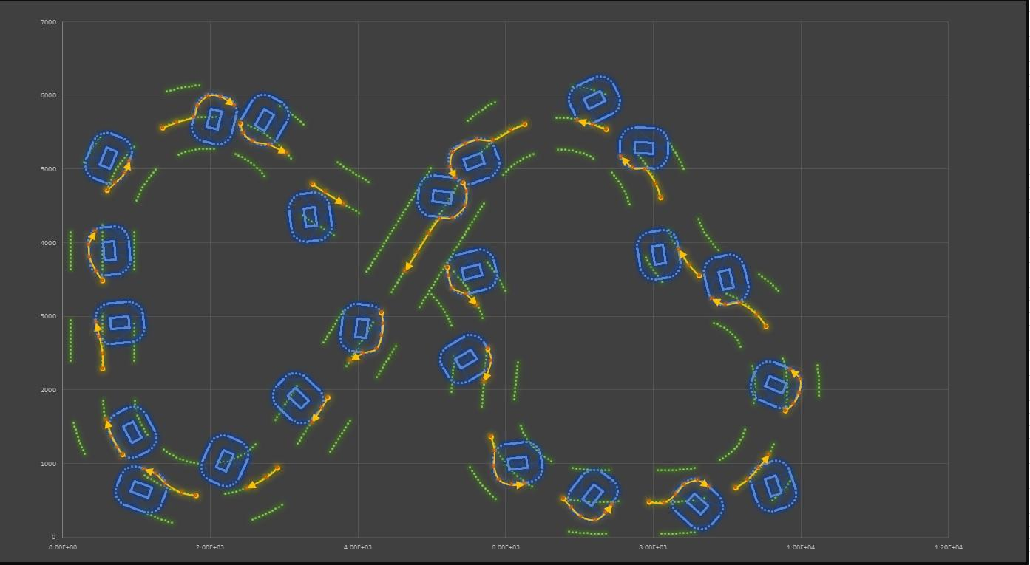
Obstacle Detection
Path finder: Obstacle Avoider

Slide 33
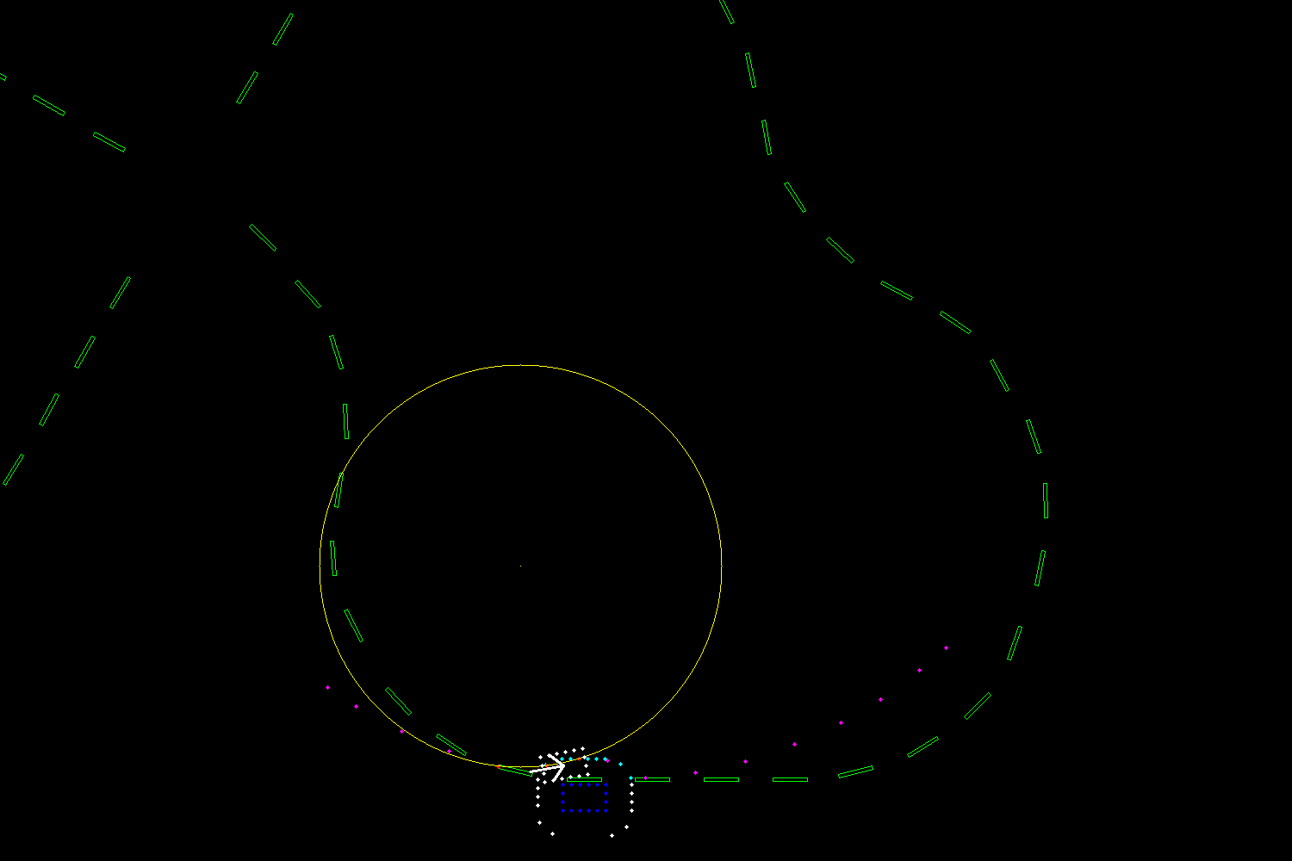
Obstacle Detection
Lidar detects objects
Creating offsetted points used for overtaking

Slide 34
Main Objectives
Lane Following
Obstacle Detection (Overtaking)
Parking

Slide 35
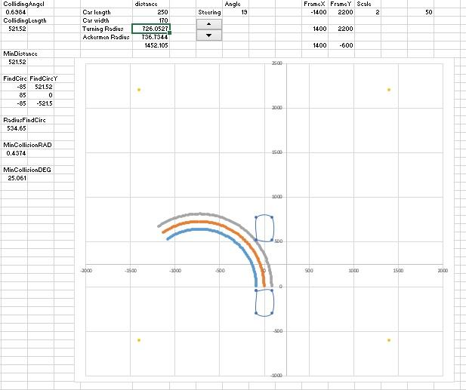
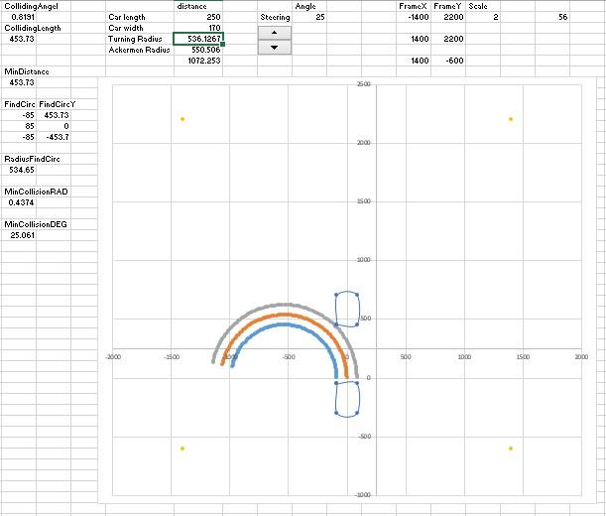
Parking

Slide 36
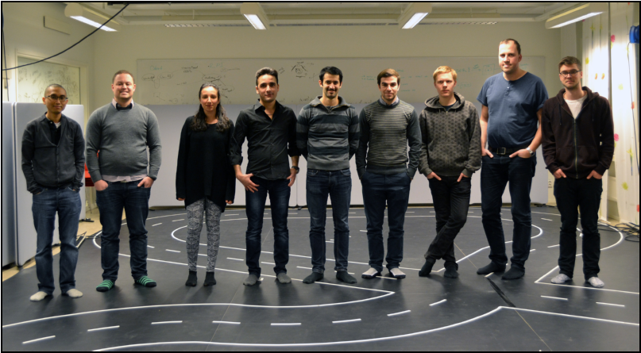
Thank You for Listening!
Follow us at: tetrix-carolocup.blogspot.se

